Slide 1
Subtopic N3.10 – Multiples
LEARNING OUTCOME: To understand and be able to list multiples of a number.
Keywords:
Multiple
Factors
Prime number
Prime factor
Objectives:
List the multiple of any given integer.
Identify the multiples of a given integer in a list of numbers.
To identify common multiples of two or more numbers.
Introduction – read and annotate:
So far, you’ve been using multiplication to solve problems. Now, you’re going to learn about
multiples, which are the numbers you get when you count in times tables. For example, the multiples
of 4 are 4, 8, 12, 16, and so on. Understanding multiples will also help you later when you learn how
to find the lowest common multiple (LCM) of two or more numbers.
Definition
Characteristics
A multiple is the result of multiplying a positive integer by another positive integer.
Often given as a list by multiplying the same number by 1, 2, 3, 4 etc. in turn.
Will always be greater than or equal to the starting number.
Examples
Multiples
Multiples of 6 =
1 x 6= 12, 2 x 6 = 12, 3 x 6 = 18, 4 x 6 = 24 etc.
Non - Examples
3 is not a multiple of 6
2 is not a multiple of 4 or 6 or 8 etc.
1 is not a multiple of any number except 1
Multiples of 19 =
1 x 19 = 19, 2 x 19 = 38, 3 x 19 = 57 etc.
Listing multiples
Example 1 - I do…
Example 2 – We do…
Example 3 – You do…
Steps | Write down the first five multiples of 12 | Write down the first five multiples of 7 | Write down the first five multiples of 4
1) Consider the times table of the number. 2) Write down the first five numbers in the times table of the number. | 1 x 12 = 12 2 x 12 = 24 3 x 12 = 36 4 x 12 = 48 5 x 12 = 60 | 1 x 7 = 7 2 x 7 = 14 3 x 7 = 21 4 x 7 = 28 5 x 7 = 35 | 1 x 4 = 4 2 x 4 = 8 3 x 4 = 12 4 x 4 = 16 5 x 4 = 20
 | 12, 24, 36, 48, 60 | 7, 14, 21, 28, 35 | 4, 8, 12, 16, 20

Slide 2
Independent Practice
1. Write down the first five multiples of the following numbers:
a) 5 | b) 3 | c) 10
d) 9 | e) 11 | f) 20
g) 50 | h) 35 | i) 100
j) 1 | k) 15 | l) 25
m) 24 | n) 22 | o) 62
p) 74 | q) 105 | r) 98
s) 123 | t) 321 | u) 642
5, 10, 15, 20, 25
3, 6, 9, 12, 15
10, 20, 30, 40, 50
9, 18, 27, 36, 45
11, 22, 33, 44, 55
20, 40, 60, 80, 100
50, 100, 150, 200, 250
35, 70, 105, 140, 175
100, 200, 300, 400, 500
1, 2, 3, 4, 5
15, 30, 45, 60, 75
25, 50, 75, 100, 125
24, 48, 72, 96, 120
22, 44, 66, 88, 110
62, 124, 186, 248, 310
74, 148, 222, 296, 370
105, 210, 315, 420,
525
98, 196, 294, 392, 490
123, 246, 369, 492,
615
321, 642, 963, 1284,
1605
642, 1284, 1926, 2568,
3210

Slide 3
Identifying multiples that fit specific conditions
Example 4- I do…
Example 5 – We do…
Example 6 – You do…
Steps | List all the numbers between 20 and 50 (inclusive) that are multiples of 7 | List all the numbers between 20 and 50 (inclusive) that are multiples of 5 | List all the numbers between 20 and 50 (inclusive) that are multiples of 6
1) Consider the times table of the number. 2) Write down all the multiples within the specified range.
21, 28, 35, 42, 49
20, 25, 30, 35, 40,
45, 50
24, 30, 36, 42, 48
Independent Practice
2. List all the numbers between 40 and 60 (inclusive) that are multiples of:
a) 2 | b) 3 | c) 4
d) 5 | e) 8 | f) 10
40, 42, 44, 46, 48, 50,
52, 54, 56, 58, 60
42, 45, 48, 51, 54,
57, 60
40, 44, 48, 52, 56, 60
40, 45, 50, 55, 60
40, 48, 56
40, 50, 60
3. List all the numbers between 15 and 35 (inclusive) that are multiples of:
a) 6 | b) 7 | c) 9
d) 11 | e) 18 | f) 37
18, 24, 30
21, 28, 35
18, 27
22, 33
18
No values

Slide 4

4. Here is a list of numbers:
12 15 17 20 22 25 27 30 32 35 39 40
From the list write down any numbers that are multiples of:
a) 2 | b) 5 | c) 4
d) 10 | e) 8 | f) 16
g) 15 | h) 25 | i) 1
12, 20, 22, 30, 32, 40
15, 20, 25, 30, 35, 40
12, 20, 32, 40
20, 30, 40
32, 40
32
15, 30
25
All numbers
5. Here is a list of numbers:
100 101 102 103 104 105 106 107 108 109
From the list write down any numbers that are multiples of:
a) 2 | b) 3 | c) 5
d) 4 | e) 10 | f) 11
g) 6 | h) 12 | i) 7
100, 102, 104, 106,
108
102, 105, 108
100, 105
100, 104, 108
100
None of these
102, 108
108
105

Slide 5
6. Answer the following questions:
Write down the fourth multiple of 5 | Write down the fourth multiple of 6
Write down the twelfth multiple of 6 | Write down the eighth multiple of 6
Write down the eighth multiple of 7 | Write down the eleventh multiple of 7
Write down the eleventh multiple of 12 | Write down the twentieth multiple of 12
Write down the twentieth multiple of 2 | Write down the forty-fifth multiple of 2
20
24
72
48
56
77
132
240
40
90
7. Answer the following questions:
Find the largest number below 48 that is a multiple of 7 | Find the smallest number above 48 that is a multiple of 7
Find the smallest number above 200 that is a multiple of 6 | Find the largest number below 200 that is a multiple of 6
42
49
204
198
8. True or false?
a) 3 is a multiple of 6 | True/ False | b) 6 is a multiple of 3 | True/ False
c) 9 is a multiple of 3 | True/ False | d) 9 is a multiple of 6 | True/ False
e) 18 is a multiple of 6 | True/ False | f) 18 is a multiple of 3 | True/ False

Slide 6
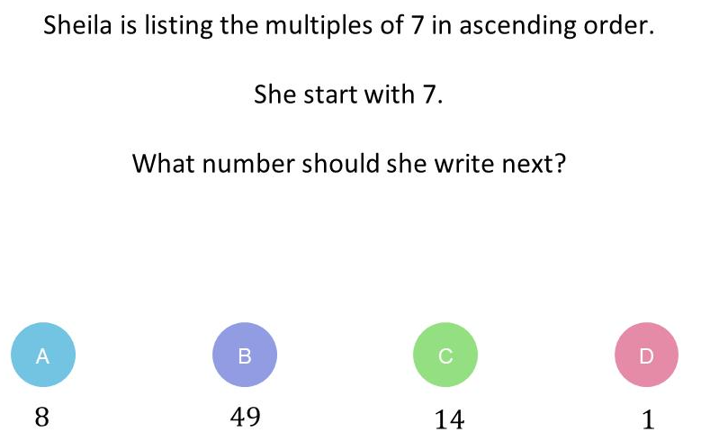
g) 18 is a multiple of 1 | True/ False | h) 18 is a multiple of 18 | True/ False
i) 18 is a multiple of 9 | True/ False | j) 9 is a multiple of 9 | True/ False
k) 7 is a multiple of 7 | True/ False | l) 17 is a multiple of 7 | True/ False
m) 27 is a multiple of 7 | True/ False | n) 37 is a multiple of 7 | True/ False
o) 36 is a multiple of 6 | True/ False | p) 36 is a multiple of 12 | True/ False
q) 36 is a multiple of 24 | True/ False | r) 6 is a multiple of 24 | True/ False
s) 24 is a multiple of 6 | True/ False | t) 24 is a multiple of 1 | True/ False
u) 1 is a multiple of 1 | True/ False | v) 1 is a multiple of 2 | True/ False
9. A light flashes every 8 seconds. How many times will it flash in 3 minutes?
22
Skills Check
Sheila is listing the multiples of 7 in ascending order.
She starts with 7. What number should she write next?
Which of these is not a multiple of 8?
8 4 40 800

